Slide 1
CHARITY DONATION WEB/APP
// EPICS COMMUNITY PROJECT
PHASE - 1 REVIEW
EPICS CHARITY DONATION
Charity Donation web/app

Slide 2
TEAM MEMBERS
// EPICS CHARITY DONATION WEB/APP
Utkarsh Varshney 19BCY10018 Aditya Kunal Bhate 19BCE10046 Bhumil Modi 19BAI10007 Hardik Mahto 19BAI10126
Ashwin Parshuram 19BCG10073 Abhinav Pandey 19BCY10032 Ameya Mathur 19BCG10062 Margik Bhatt 19BCY10125

Slide 3
01
PROBLEM IDENTIFICATION

Slide 4
PROBLEM IDENTIFICATION
​
⇒ In this COVID-19 pandemic, the biggest problems faced by the NGOs were financial stress and unpreparedness for technical support.​
Q. How did they face Financial Stress?​
Given that the typical sources of funding such as philanthropy and corporate social responsibility (CSR) are now flowing towards COVID-19 relief and healthcare-related work, there are concerns among nonprofits regarding the long-term sustainability of their programs and organizations.​
Q. What about unpreparedness for technical support?​
Most organizations shared that they had been procrastinating on digital technology adoption in their operations and the sudden lockdown caught them completely unprepared. Due to the lack of digital skills within teams, many are struggling to work remotely. Nonprofits that had already introduced digital technology in their operations and programs are finding it easier to cope​

Slide 5
PROBLEM IDENTIFICATION
Out of an annual average CSR budget of Rs 15,000 crore, more than half i.e. Rs 7,863 crore has been allocated towards Covid-19 relief measures, including Rs 5,324 crore for PM-Cares Fund, according to Sattva’s India Data Insights report on CSR’s Covid-19 Response and Outlook for FY 2020-21.​
Lack of proper networking: For some NGOs is difficult to network. Having poor network with pairs can lead to lack of communication, if non-governmental organizations do not disclose what they are doing for a certain community, efforts could be duplicated, conflicts about the ways a certain problem should be faced in a region could arise, and they could be missing the opportunity to learn best practices from other NGOs.​

Slide 6
PROBLEM IDENTIFICATION
Lack of Credibility:​ This is perhaps the most plaguing issue for NGOs operating in India. During the last few years, numerous organisations have mushroomed which claim to work for the cause of helping poor. Under the garb of being an NGO, these NGOs often mint money from donors. In order to generate the right quantities of funds to execute their projects, it is vital for NGOs to function like business entities. But NGOs should not become pure businesses either. There is a need for a rating system to be in place for NGOs which ranks them on the basis of the seriousness of their work and their openness to getting audited and scrutinized.​

Slide 7
PROBLEM IDENTIFICATION
Getting people to support an NGO: NGOs often struggle to market themselves. Owing to the challenges discussed above, it’s a daunting task for the NGOs to come up with the right communication to connect with their potential donors. ⇒ And it’s not just about donations alone. NGOs also have a tough time in campaigning – that is spreading the word about their cause(s) effectively and striking a chord with the masses.​ ⇒ It is vital for NGOs to register in the minds of their existing and potential donors that they are into doing some truly serious work for the cause they stand for.​

Slide 8
02
PROBLEM STATEMENT

Slide 9
PROBLEM STATEMENT
⇒ With so many NGOs working in India, there are several problems that’ve arised:
No possible sync between all the NGOs working.
Lack of Tech Support for NGOs is a big problem in India.
Lot of Fake NGO’s make it difficult to donate.

Slide 10
03
EXISTING WORK & LIMITATIONS

Slide 11
EXISTING WORK & LIMITATIONS
Give India ( https://www.giveindia.org/)​: GiveIndia exists to alleviate poverty by enabling the world to give. Established in 2000, it is the largest and the most trusted giving platform in India. ⇒ It enables individuals and organizations to raise and donate funds conveniently to any cause they care about, with offerings including crowdfunding, corporate giving, cause marketing, and philanthropy consulting. ⇒ GiveIndia’s community of 2M+ donors and 250+ partners have supported 2,200+ verified nonprofits, serving 15M+ people across the country.​

Slide 12
EXISTING WORK & LIMITATIONS
Uday Foundation(https://www.udayfoundation.org/about-us/)​
⇒ Encourage people to contribute by making a small in-kind donation as they feel contribution towards this cause not only gives them immense satisfaction but it also connects them with Indian culture where donating food, clothes & water is termed to be a very noble gesture.​
Limitation: It is only based for single organization and only one type of donation whereas our website connect all different kind of donations for anyone who wants to donate .

Slide 13
04
SYSTEM ARCHITECTURE

Slide 14
SYSTEM ARCHITECTURE
Page 1 – HOME PAGE ​
- Nav Bar (aboutus, contact, login, signup)​
- 1st section (website info)​
- 2nd section (motive) (if interested sign-up)​
- 3rd section (contact)​
Page 2 – SIGN UP (if clicked on sign up button)​
- Sign Up page (user, email, phone, password, captcha, register button)​
- Popup Display (if not verified) (5 secs to home page)​
- Go to Page 3 (if verified)​

Slide 15
SYSTEM ARCHITECTURE
Page 3 – Log In (if clicked on login button)​
- Login Page (user, password, submitbutton)​
- Popup Display (wrong fields)​
- Go to Page 4 (correct fields)​
Page 4 – Main Page​
- Nearby NGOs​ - Can see details of different ngos​
- Also the user can join them or donate to a specific NGO.​
- User Profile​
- Log-out​

Slide 16
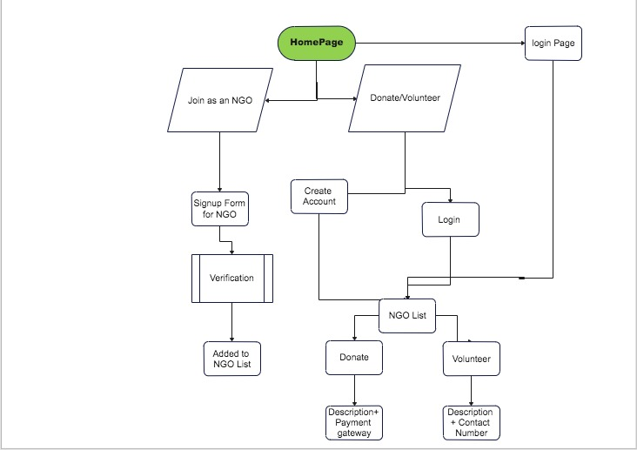
SYSTEM ARCHITECTURE

Slide 17
05
WORKING PRINCIPLE

Slide 18
OUR SOLUTION - 3 MAIN REASONS
Highly functional Web Application that provided a platform for NGOs all around the country. This solves the lack of technical support faced by them.​
Since, the web-app would be containing both donate and volunteer options, it would also solve the problem of finding trusted NGOs since all users and NGOs on the app would be registered only after they provide authenticate IDs.​
It would also help increase their reach to the people who are likely to donate which would directly solve the problem of financial crisis.​

Slide 19
06
EXPECTED RESULTS

Slide 20

EXPECTED RESULTS

Slide 21
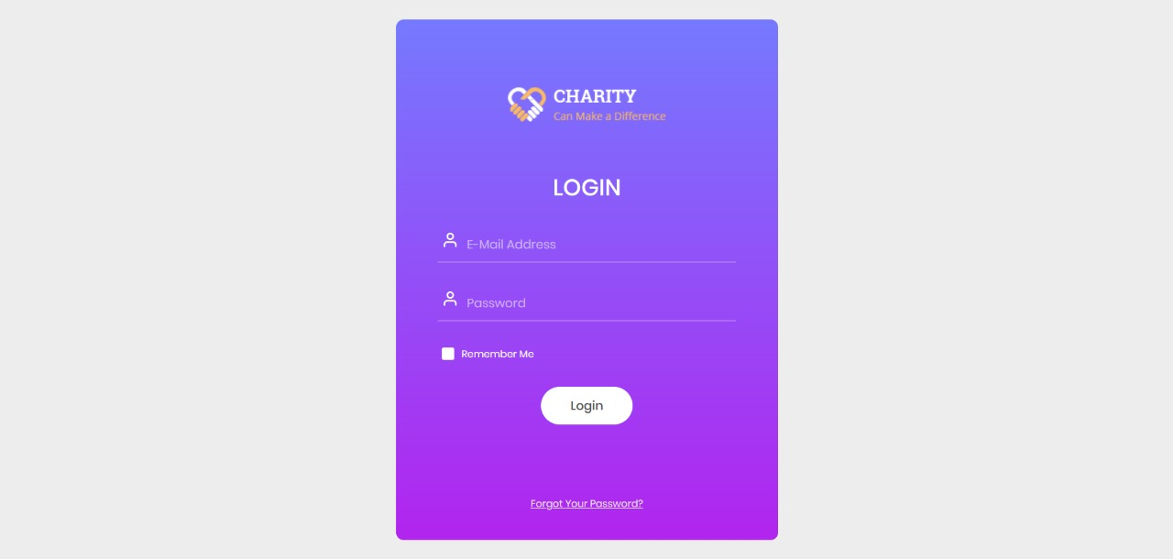
EXPECTED RESULTS

Slide 22

THANKS!
// EPICS CHARITY DONATION WEB/APP
DO YOU HAVE ANY QUESTIONS?
Please keep this slide for attribution

